Slide 1
Spatial Mapping in R
Tiziana Gelmi-Candusso
Mark Jordan

Slide 2


Mark Jordan
Associate Professor of Biology
Seattle University
jordanma@seattleu.edu
Tiziana Gelmi Candusso
Postdoctoral Fellow
University of Toronto
tiziana.gelmicandusso@utoronto.ca

Slide 3
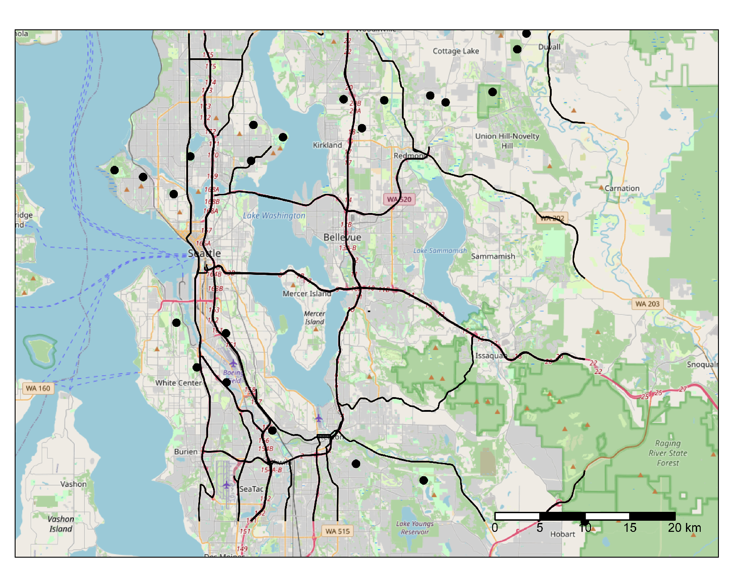
What is spatial data?
Data that references a specific geographic location
Landscape features (natural or built)
Environmental properties (temperature, air quality)

Slide 4
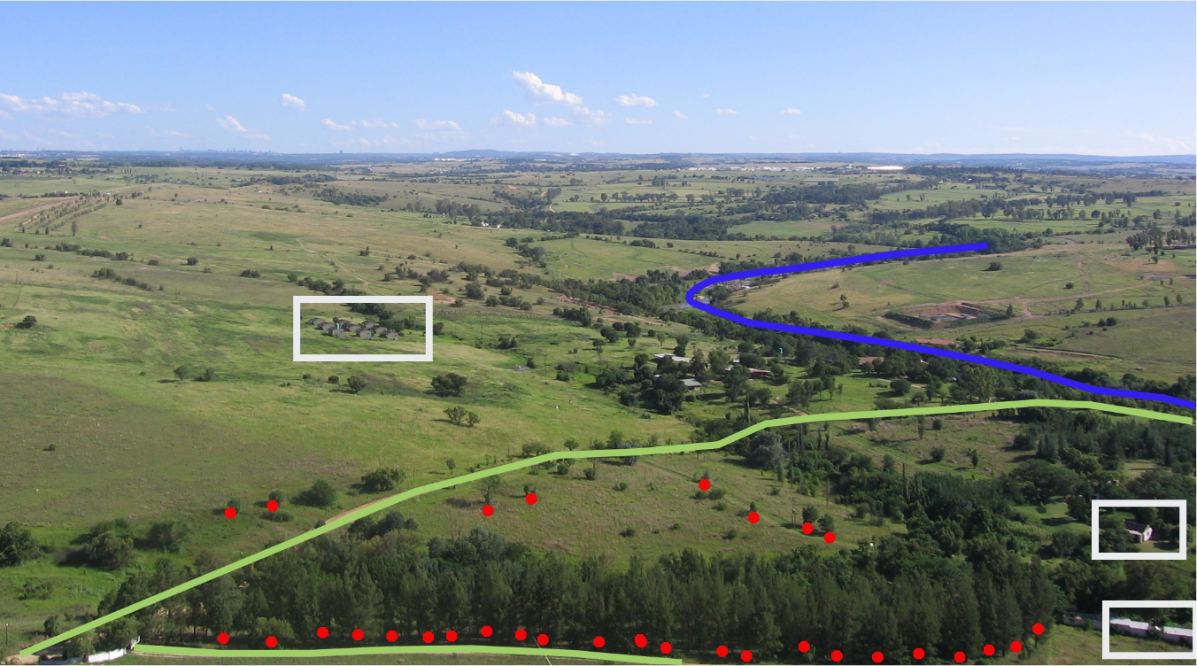
Types of spatial data - vectors
Lines
Polygons
Points

Slide 5
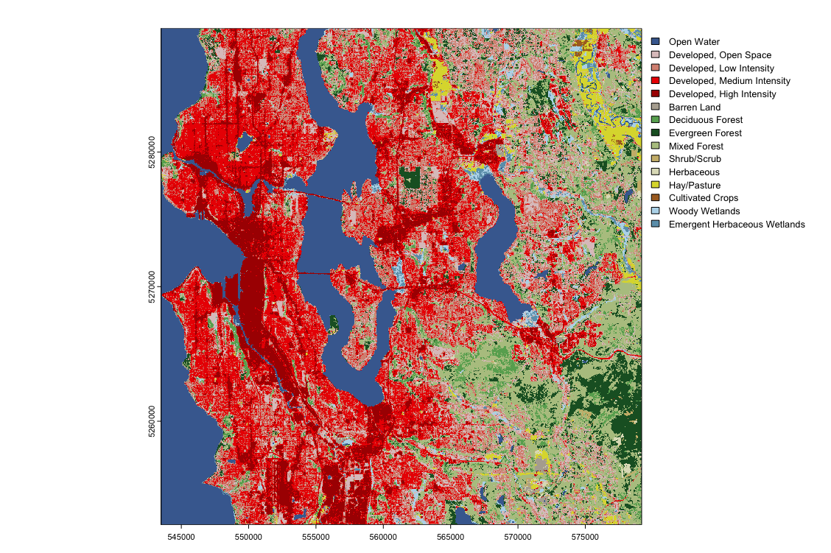
Types of spatial data - rasters

Slide 6
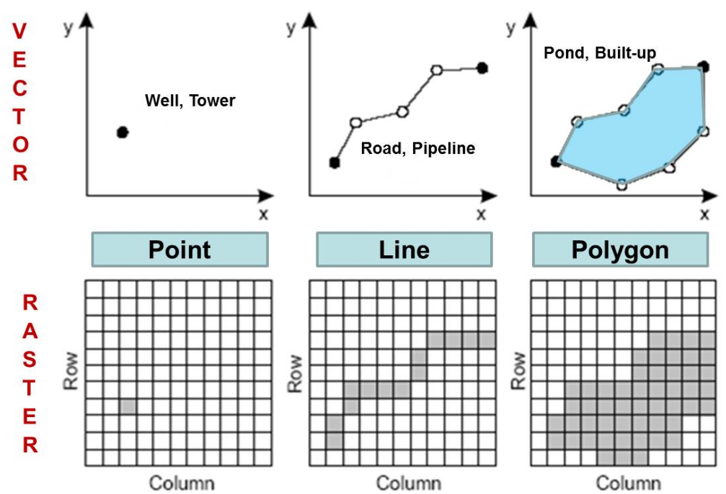
Comparison of vector and raster data

Slide 7
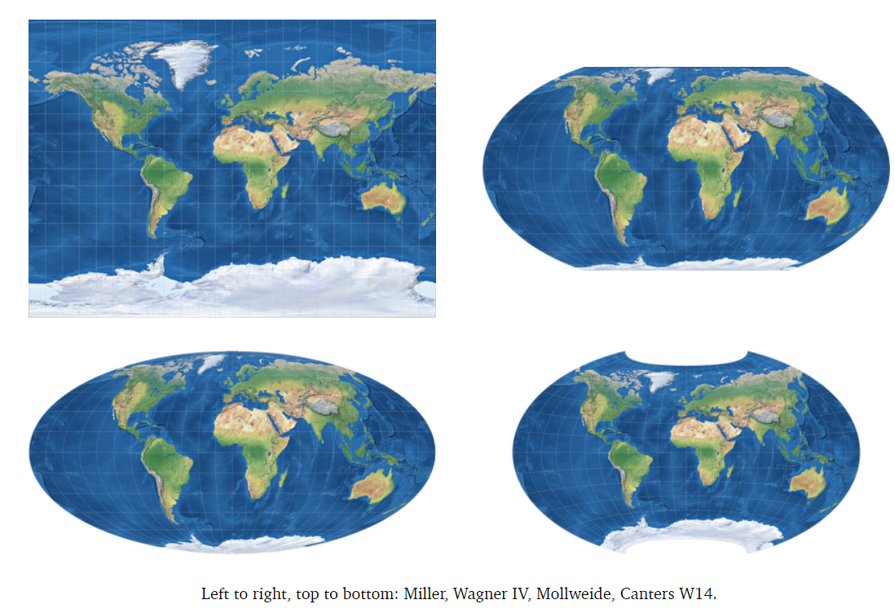
Projections and Spatial Reference Systems (SRS)
Projection - method for “flattening” the globe
SRS - combination of a projection and a coordinate system (x,y)

Slide 8
Why should you use R for spatial data?
Free and open source
Computationally faster
Save your work in a script file:
Replicability
Back-tracing
Collaboration through Github
All analysis in one place

Slide 9
Using R with spatial data
Packages: sf and terra
sf: traditional method for working with vector data, reads shapefiles as spatial dataframes
terra: newer, handles both vector and raster data, reads shapefiles as SpatVectors and rasters as SpatRasters
Other useful packages
Other mapping packages we’ll use: tmap and tidyterra
They have equivalent functions for most processes. (linked in tutorial)
For some functions we need to convert between sf to terra, using st_as_sf() or vect()

Slide 10

Tutorial outline
We will develop the full analytical process of importing, extracting and analyzing spatially explicit data from camera traps
Vector data
Points: camera trap results
Lines: roads
Polygons: forest cover
Raster data: NDVI and building density
Downstream analysis of processed spatial data
Spatial analysis skills
Importing data
Re-projecting data
Making maps
Analyzing data

